Slide 1
Digital Portfolio
STUDENT NAME: D. Dhanushya
REGISTER NO AND NMID: 2422k2240 and asbru092422k2240
DEPARTMENT: BSc. Computer science
COLLEGE: Government Arts college Udumalpet/ Bharathiar University

Slide 2
PROJECT TITLE
Data Analyst

Slide 3


AGENDA
Problem Statement
Project Overview
End Users
Tools and Technologies
Portfolio design and Layout
Features and Functionality
Results and Screenshots
Conclusion
Github Link
3/21/2024 Annual Review

Slide 4

PROBLEM STATEMENT
Many freshers and professionals struggle to present their skills and projects effectively to recruiters. A Data Analyst portfolio is required to showcase technical skills, data handling capabilities, and project outcomes in a structured and interactive way.

Slide 5

PROJECT OVERVIEW
The Data Analyst Portfolio project is designed to showcase skills in data collection, cleaning, visualization, and interpretation. It highlights the use of tools and technologies such as Excel, SQL, Python, and visualization platforms like Power BI/Tableau. The portfolio demonstrates how data can be transformed into meaningful insights that support decision-making and problem-solving.

Slide 6

WHO ARE THE END USERS?
1. Business Executives / Managers – use insights for strategic decision-making.
2. Marketing Teams – analyze customer behavior, campaigns, and sales performance.
3. Finance Departments – track revenue, expenses, and forecast budgets.
4. HR Teams – monitor employee performance, recruitment, and retention trends.
5. IT Departments – improve system efficiency and detect anomalies.
6. Clients / Customers – benefit indirectly through better products and services.

Slide 7

TOOLS AND TECHNIQUES
🔧 Tools
Excel / Google Sheets
SQL
Python / R
Power BI / Tableau
Jupyter Notebook
📊 Techniques
Data Collection & Cleaning
Exploratory Data Analysis (EDA)
Statistical Analysis
Data Visualization
Predictive Modeling
Reporting & Insights

Slide 8
POTFOLIO DESIGN AND LAYOUT
🎨 Design
Simple, clean, and professional theme
Consistent colors & fonts for readability
Interactive sections for better navigation
Visual focus on data projects & dashboards
📂 Layout
1. Home / Introduction – Name, role, and short bio
2. About Me – Skills, tools, and career goals
3. Projects – Case studies with datasets, methods, and results
4. Visualizations – Dashboards, charts, and insights
5. Contact – Email, LinkedIn, GitHub for networking
‹#›

Slide 9
FEATURES AND FUNCTIONALITY
✨ Features
Clean and responsive web design
Interactive navigation (Home, About, Projects, Contact)
Projects with detailed explanation & visuals
Data visualizations (charts, dashboards, reports)
Downloadable resume / project files
⚙️ Functionality
Showcases skills, tools, and techniques used
Provides real-world project case studies
Allows recruiters/clients to easily view your work
Contact form for direct communication
Portfolio acts as a personal brand for career growth

Slide 10
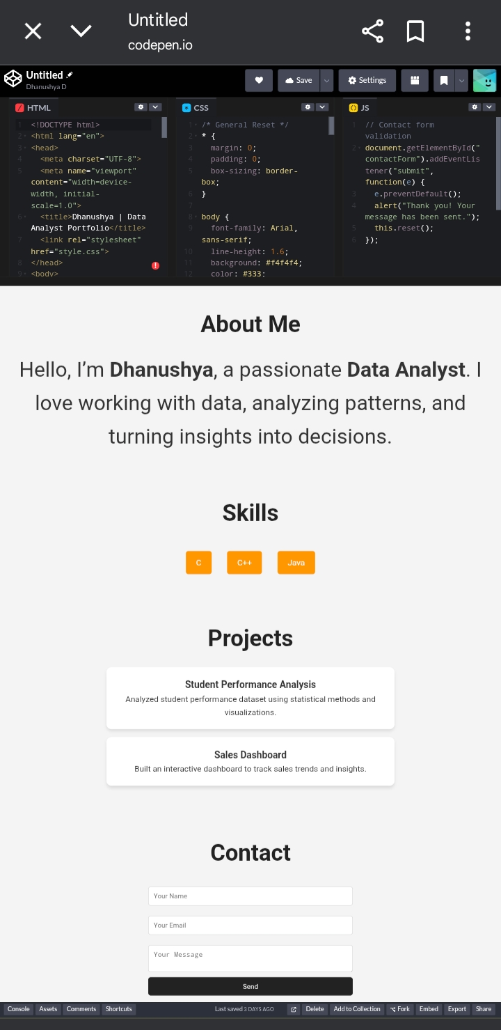

RESULTS AND SCREENSHOTS
3/21/2024 Annual Review
‹#›

Slide 11
CONCLUSION
The Data Analyst Portfolio showcases skills in data cleaning, analysis, and visualization.
Acts as a personal branding tool to highlight technical expertise.
Provides recruiters and clients with a clear view of projects and capabilities.
Bridges the gap between raw data and meaningful insights.
Supports career growth by demonstrating real-world problem-solving.
‹#›

